Slide 1

BADM 567: Study Group Session I
Process Analysis PRACTICE PROBLEMS & SOLUTIONS
GAURAV SACHDEV

Slide 2
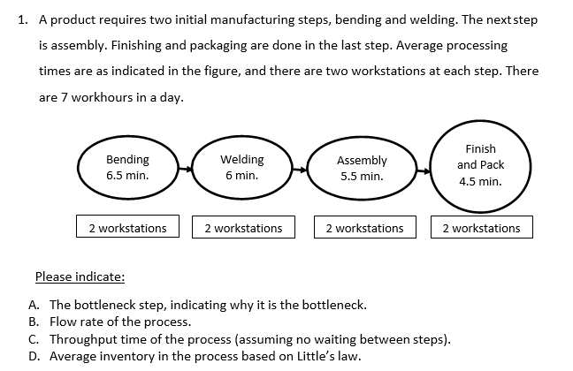
Problem #1
Bottleneck: Activity in the process with the smallest capacity
Flow Rate (R): Number of units that emerge from a process per unit of time
Throughput time (T): Total time spent by a unit in a process, from start to end
Little’s Law: I = T * R

Slide 3
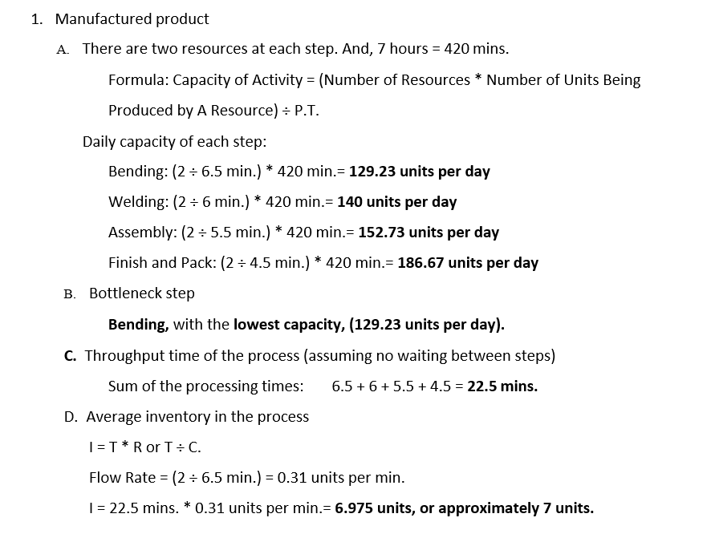
Solution #1
Bottleneck: Activity in the process with the smallest capacity
Flow Rate (R): Number of units that emerge from a process per unit of time
Throughput time (T): Total time spent by a unit in a process, from start to end
Little’s Law: I = T * R

Slide 4
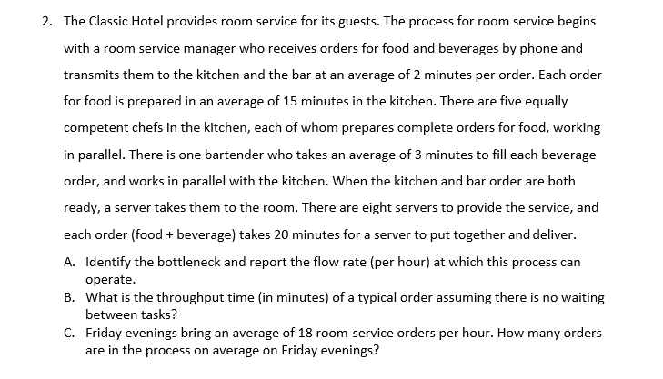
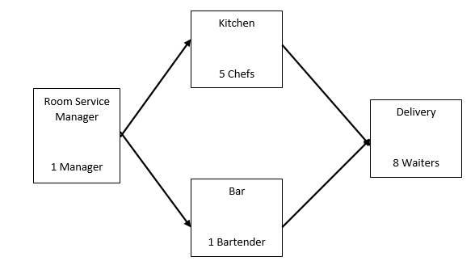
Problem #2
Bottleneck: Activity in the process with the smallest capacity
Throughput time (T): Total time spent by a unit in a process, from start to end
Little’s Law: I = T * R

Slide 5
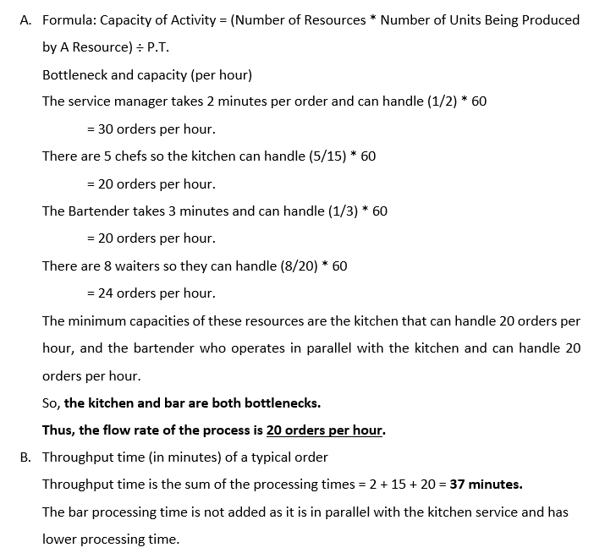
Solution #2
Bottleneck: Activity in the process with the smallest capacity
Throughput time (T): Total time spent by a unit in a process, from start to end
Little’s Law: I = T * R

Slide 6
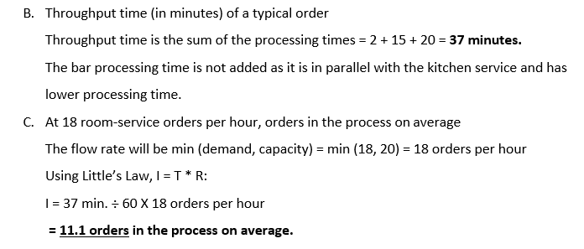
Solution #2 – Contd.
Bottleneck: Activity in the process with the smallest capacity
Throughput time (T): Total time spent by a unit in a process, from start to end
Little’s Law: I = T * R

Slide 7
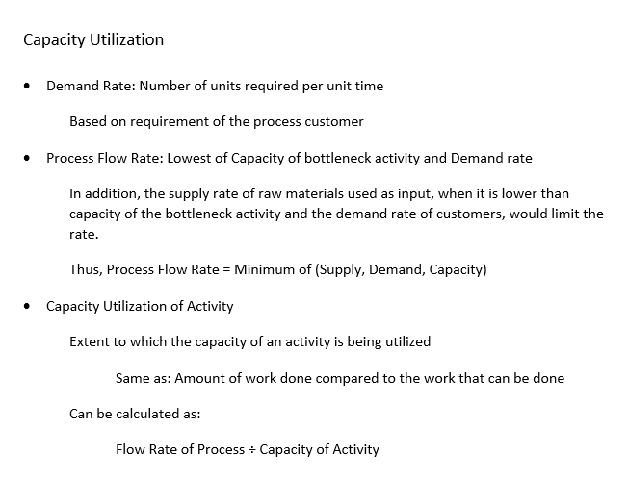
Capacity Utilization
Definitions

Slide 8
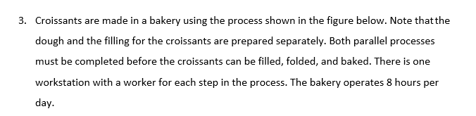
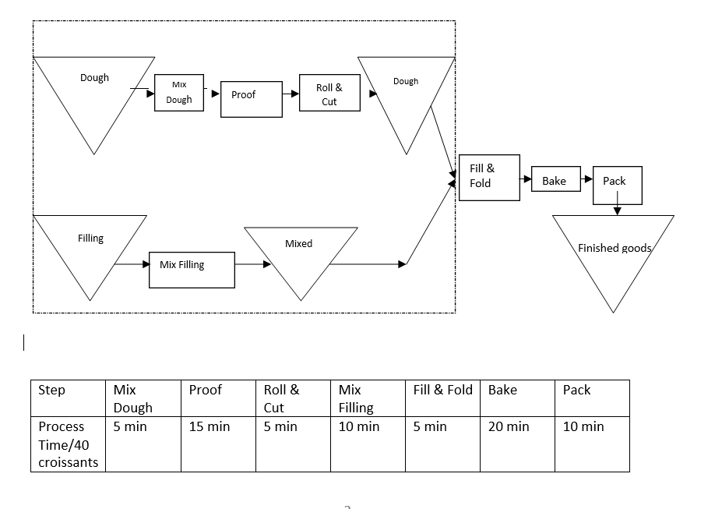
Problem #3
Find the capacity per day of each step.
What is the capacity per day for the process of preparing the dough and mixing the filling (the process within the dotted box)?
What is the overall capacity per day of the croissant making process?
What is the minimum throughput time for making a batch of croissants?
If the process is operating at bottleneck step capacity, what is the capacity utilization of each step?

Slide 9
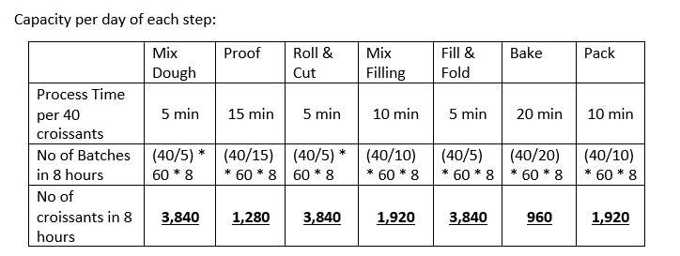
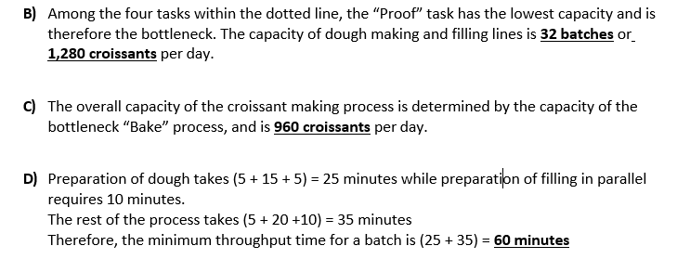
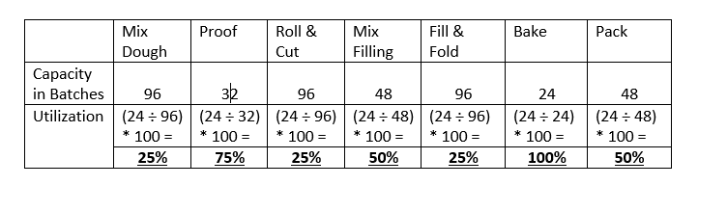
Solution #3
Find the capacity per day of each step.
What is the capacity per day for the process of preparing the dough and mixing the filling (the process within the dotted box)?
What is the overall capacity per day of the croissant making process?
What is the minimum throughput time for making a batch of croissants?
If the process is operating at bottleneck step capacity, what is the capacity utilization of each step?

